Slide 1
CONSUMER BEHAVIOUR TOWARDS BUYING AN ELECTRIC VEHICLE
UNIVERSITY ROLL NO. : 213026-11-00-57
UNIVERSITY REGISTRATION NO. : 026-1211-0130-21
PAPER CODE : DSE B2

Slide 2
INTRODUCTION:
A simple still reasonable connection is comprehended between environment and consumer behaviour towards buying an EV among people of age below 18-30 above in our dataset.
Consumer behavior towards buying electric vehicles is influenced by factors like environmental concerns, government incentives, and long-term cost savings, but barriers such as higher battery replacement costs, mileage and limited charging infrastructure still affect purchasing decisions.
Objective of the study:
To understand the buying behavior of consumers towards electric vehicles.
To recognize the important parameters affecting consumers’ vehicle purchasing decisions.
To understand the growth of electric vehicles industry in India.

Slide 3
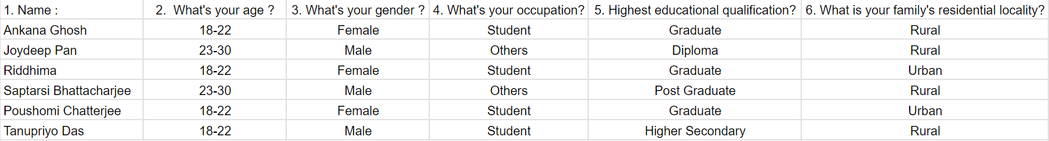
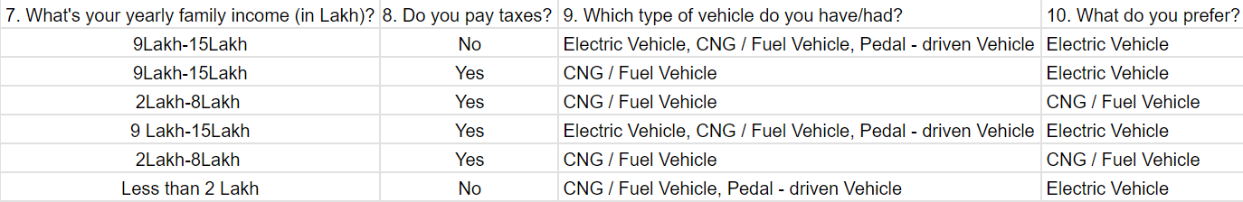
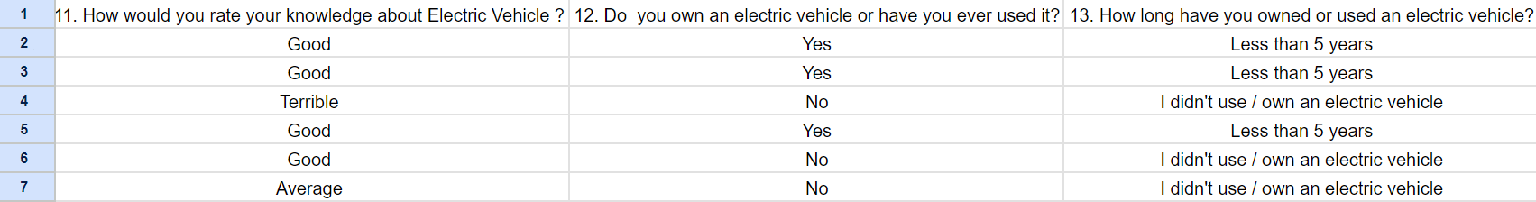
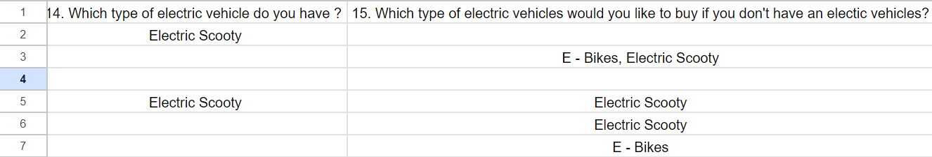
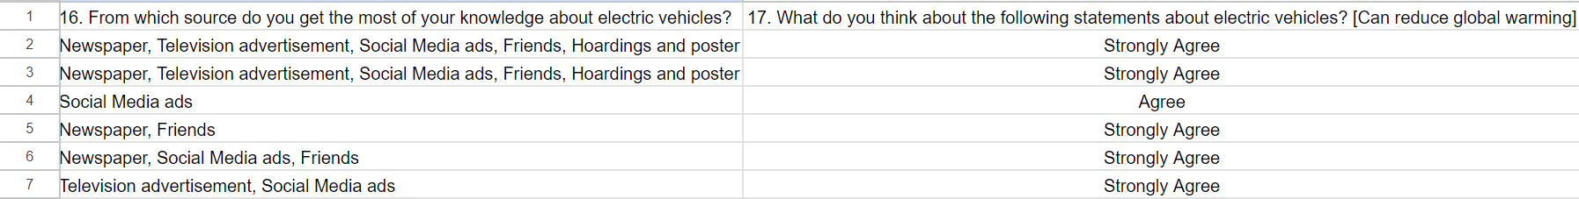
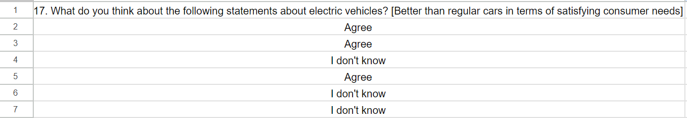
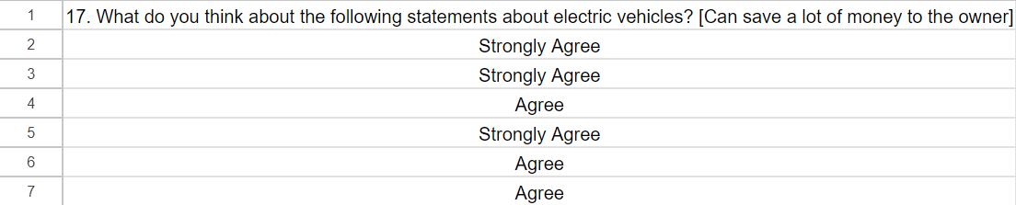
DATASET :

Slide 4
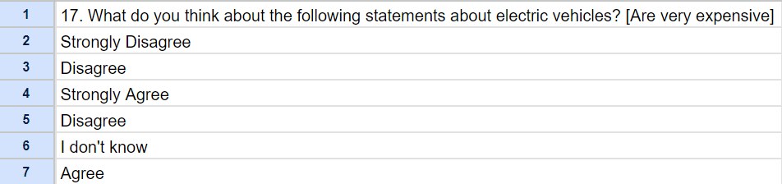
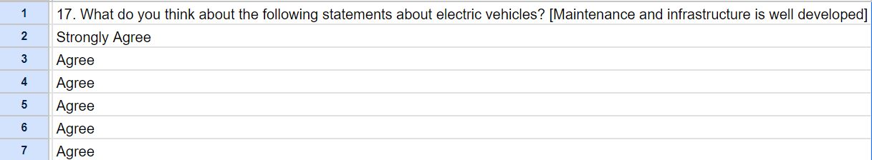
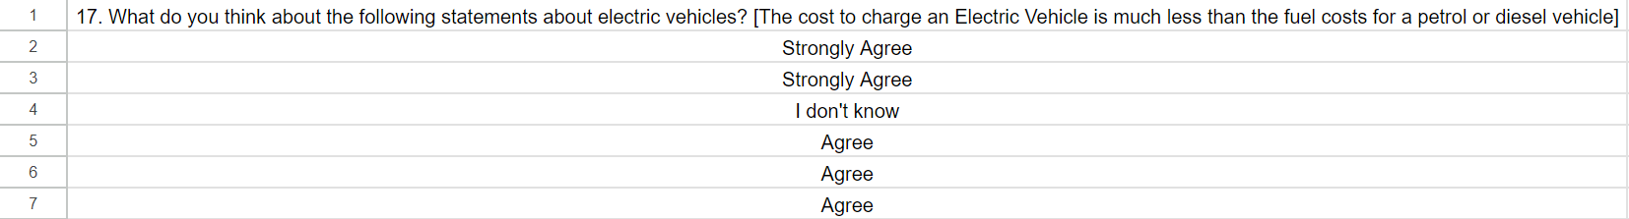
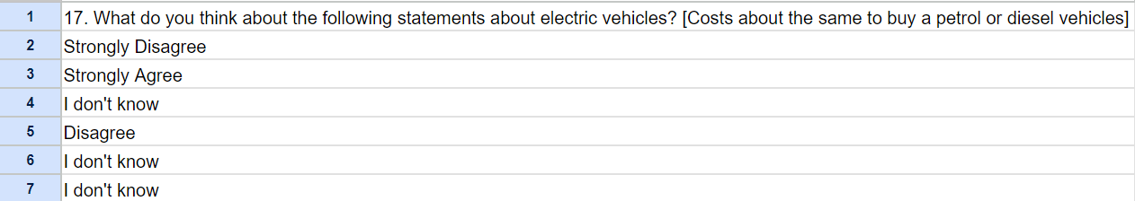
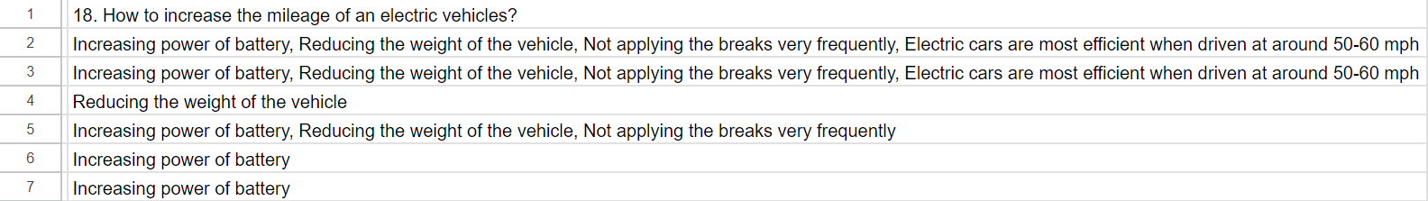
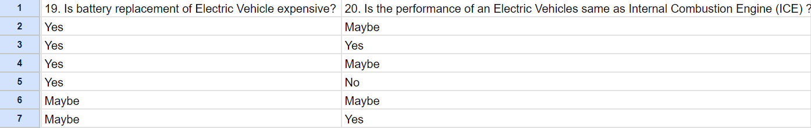
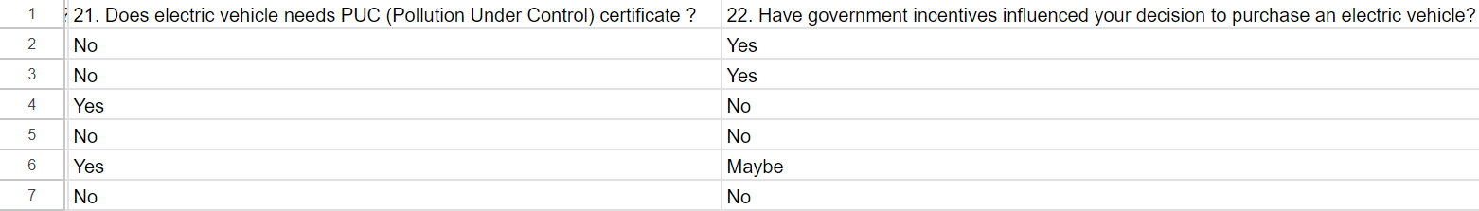

Slide 5
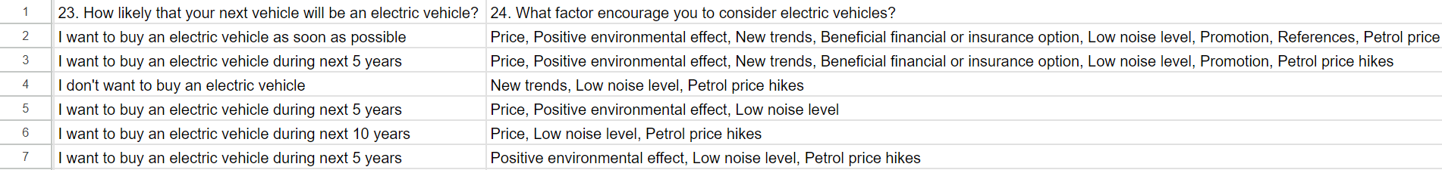
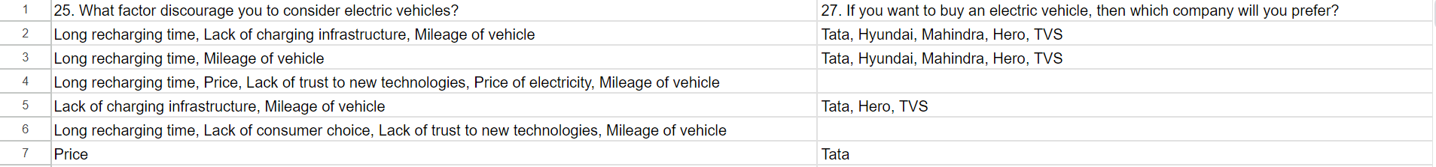
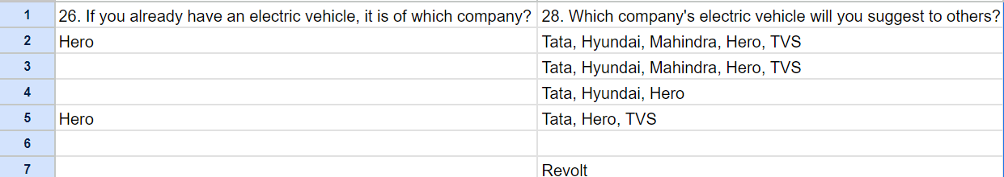
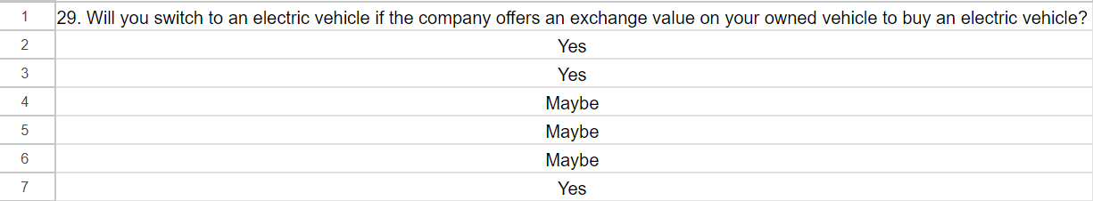
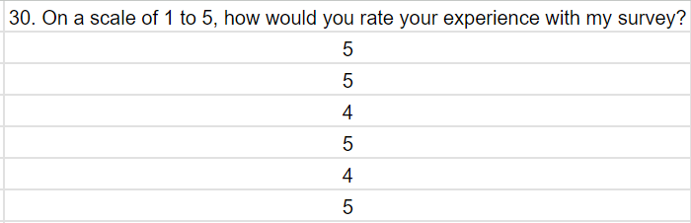

Slide 6
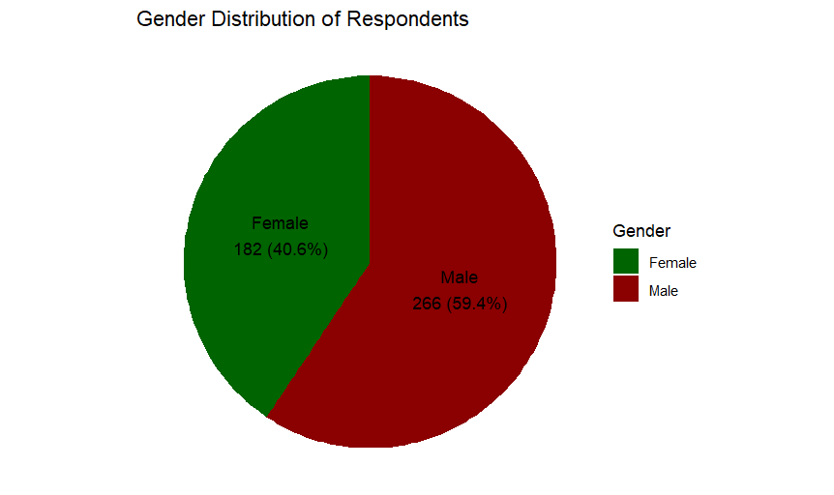
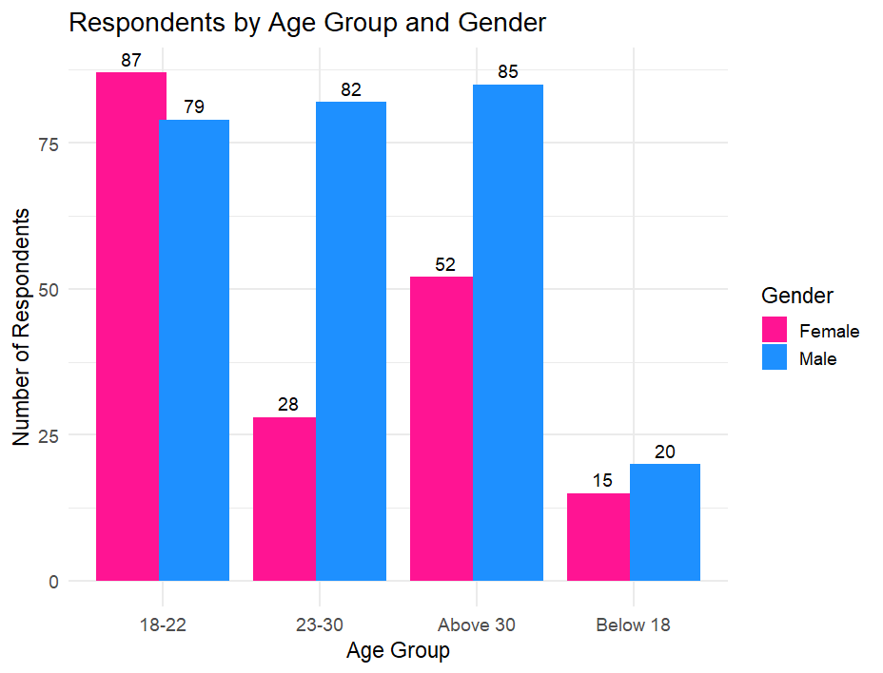
EXPLAnATORy DATA ANALYSIS :-
Interpretation: The data we get from our survey is that
there are 266 male respondents and 182 female respondents.
Interpretation: The data we get from our survey is that there are 266 male respondents and 182 female respondents which is represented in a pie chart.
Interpretation: This graph represents Age Vs. Gender . We can see that in between age group of 18-22 years 87 respondents are female and 79 respondents are male. In between age group of 23 – 30 years total number of female respondents are 28 and total number of male respondents are 82. Above 30 years of old there are 52 female respondents and 85 male respondents. And also below 18 years of age 15 respondents are female and 20 respondents are male .

Slide 7
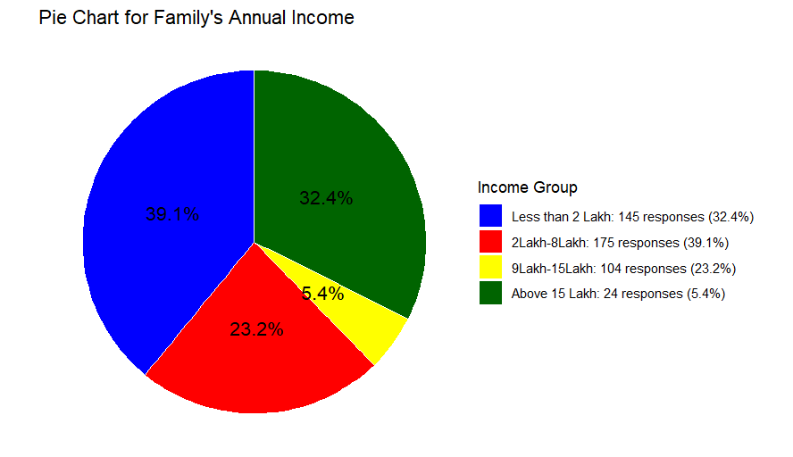
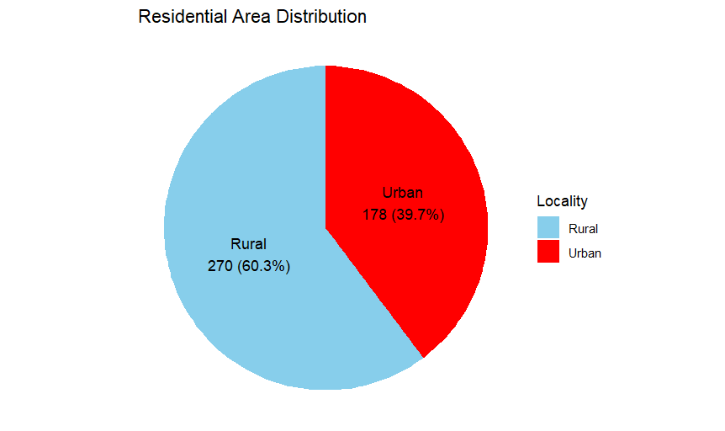
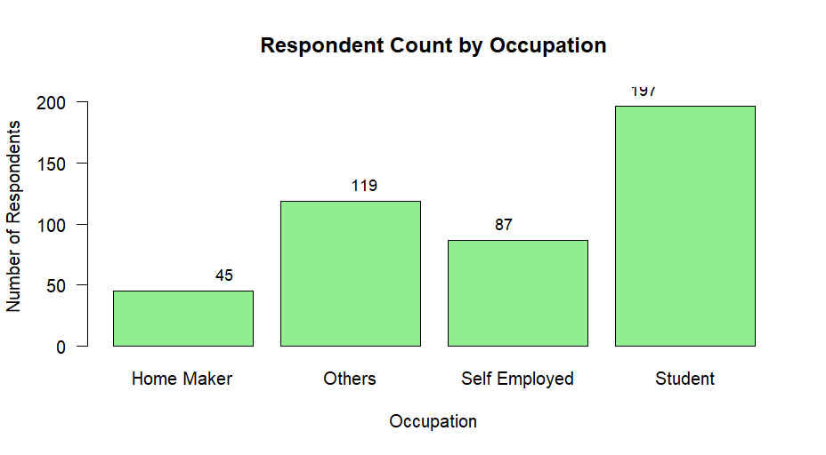
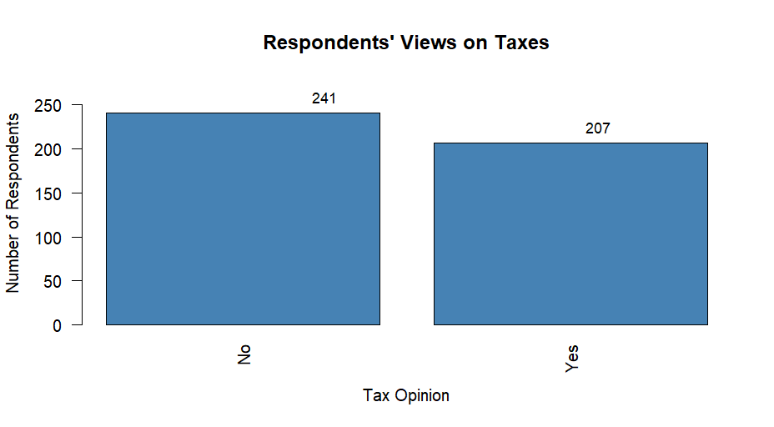
Interpretation: This graph shows that out of 448 respondents, 178 reside in urban areas and 270 reside in rural areas.
Interpretation: The graph represents that out of 448 respondents, the occupation of 45 respondents are home maker, 87 are self employed, 197 are students and 119 have other ways of occupation.
Interpretation: The pie chart represents that 145 respondents have family income less than 2 Lakh , 175 respondents have family income in between 2 Lakh – 8 Lakh . In between 9-15 Lakh there are 104 respondents and above 15 Lakh there are 24 respondents .
Interpretation: The bar chart represents that 241 respondents doesn’t pay any taxes and 207 people pay taxes. From this we can also conclude that 241 people have annual family income less than 3.5Lakh.

Slide 8
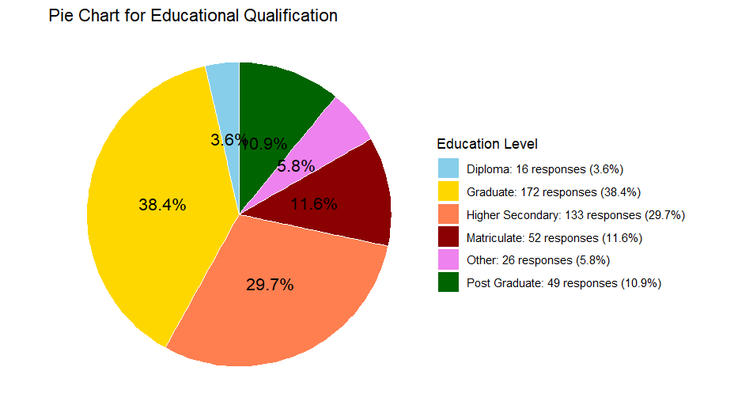
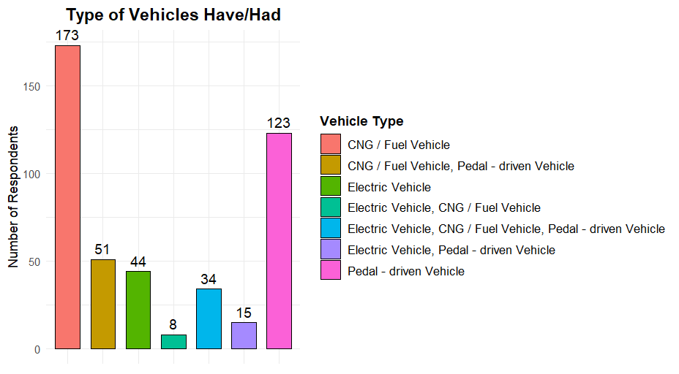
Interpretation: These bar chart gives us the details of vehicles respondents have/had. Out of 448 respondents 173 respondents have only CNG/ Fuel vehicle , 51 respondents have CNG/Fuel vehicle and pedal – driven vehicle , 45 respondents have only EV , 8 respondents have EV and CNG/Fuel vehicle , 34 respondents have EV , CNG/Fuel vehicle as well as pedal driven vehicle and 122 respondents have only pedal - driven vehicle .
Interpretation: From this pie chart we can see that 16 respondents have educational qualification of Diploma, 52 respondents have educational qualification upto matriculate , 133 respondents have educational qualification upto higher secondary , 172 respondents have educational qualification upto graduation , 49 respondents have educational qualification upto post diploma and 29 respondents have any other educational qualification.

Slide 9
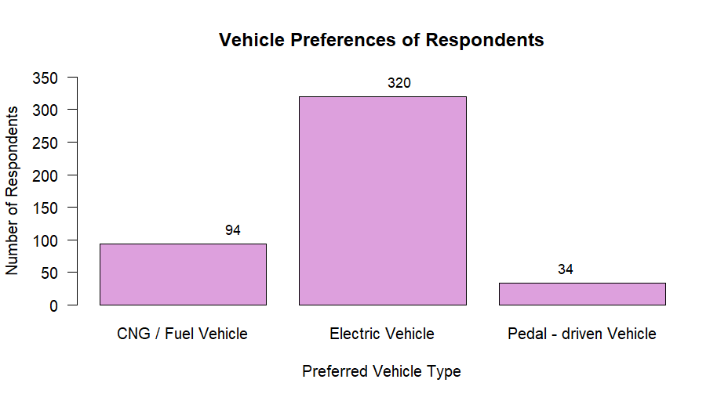
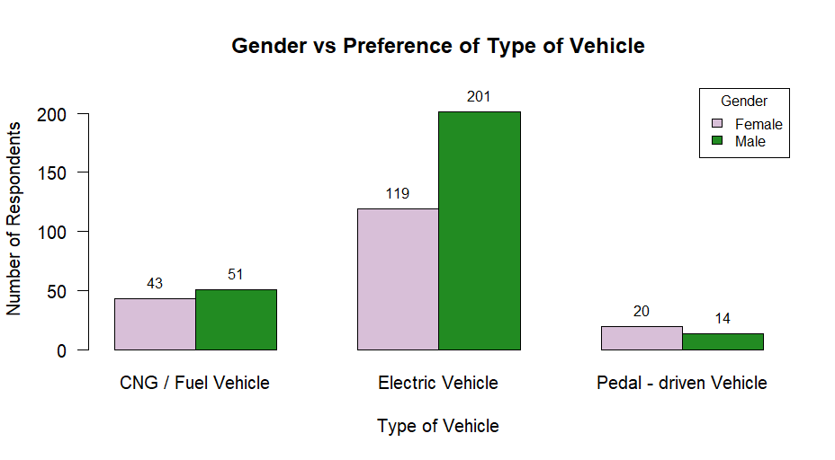
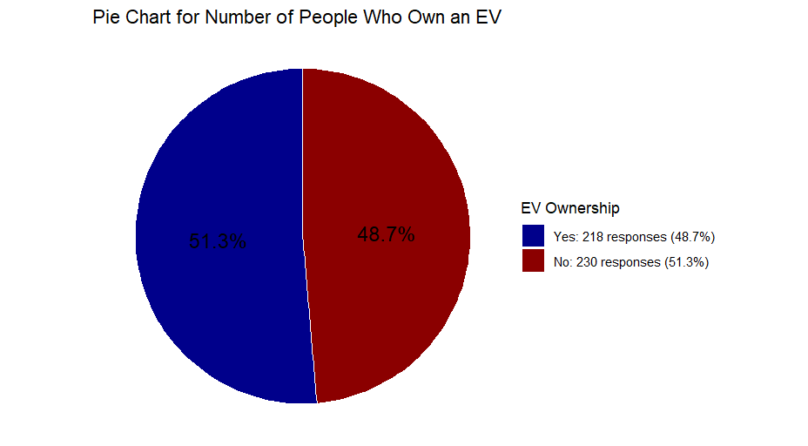
Interpretation: This bar plot gives us an idea of gender vs. preference of vehicles.
In case of females , 43 respondents pefers CNG/Fuel vehicle, 119 prefers Electric Vehicle and 20 prefers Pedal-driven vehicle .
In case of male respondents, 51 prefers CNG/Fuel vehicle, 201 prefers EV and 14 prefers Pedal-driven Vehicle.
Interpretation: Among 448 respondents 94 prefers CNG/Fuel vehicle , 320 prefers EV , 34 prefers pedal – driven vehicle.
Interpretation: Among 448 respondents 218 already have an EV and 230 respondents doesn’t have an EV.

Slide 10
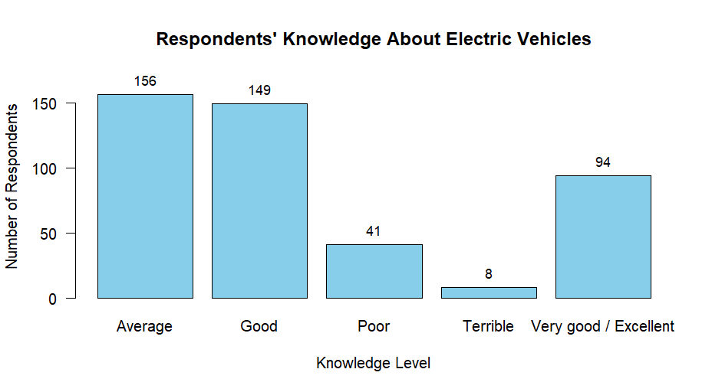
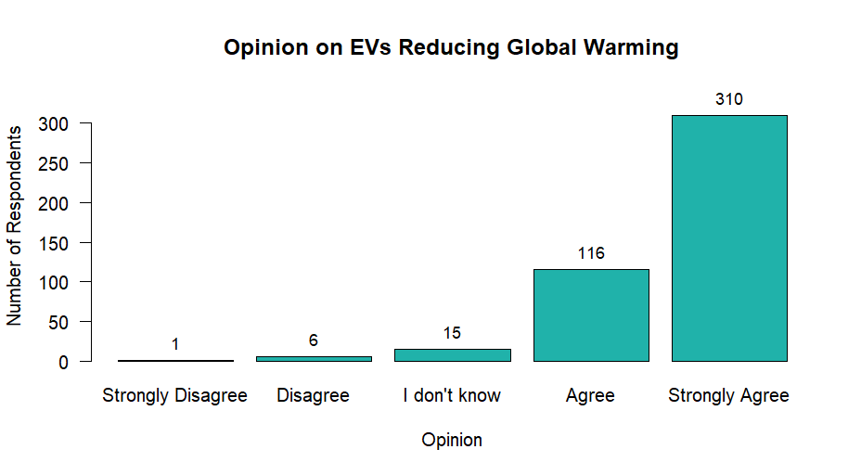
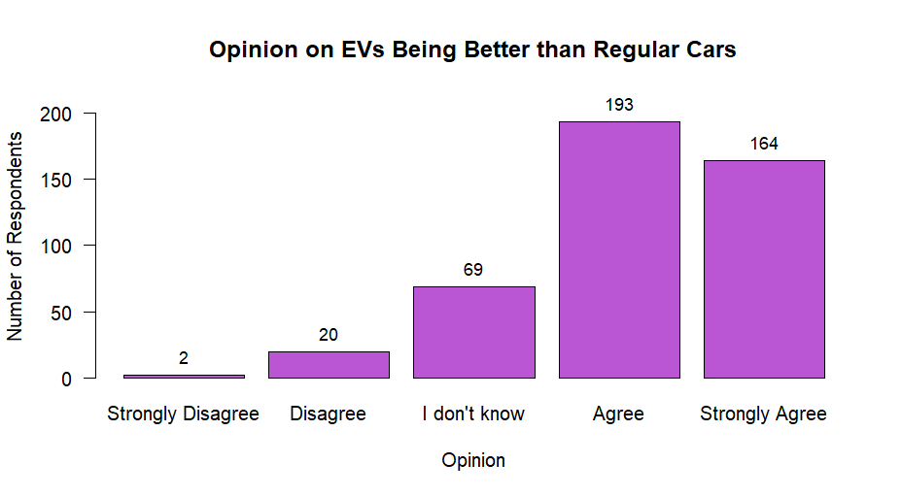
Interpretation: From this bar plot we can conclude that 310 respondents strongly agrees with the fact that EV reduces global warming . 116 respondents agrees that EV reduces global warming . 15 respondents doesn’t know about this topic and 6 respondents disagrees and 1 respondant disagreed that EV can reduce global warming. So from this data we can conclude that 426 people are aware of the fact that EV can reduce global warming .
Interpretation: This bar plot represents that 94 respondents have very good/excellent knowledge about EV , 156 respondents have average knowledge about EV , 149 have good knowledge and 41 have poor knowledge and 8 have terrible knowledge about EV.
Interpretation: According to this bar chart 2 respondents strongly disagreed and 20 respondents disagreed with the fact that EV is better than regular cars. 193 respondents agrees that EV is better than regular cars. 69 respondents responded that they didn’t know about this fact. And 164 respondents strongly disagreed with the fact that EV serves better than regular car.

Slide 11
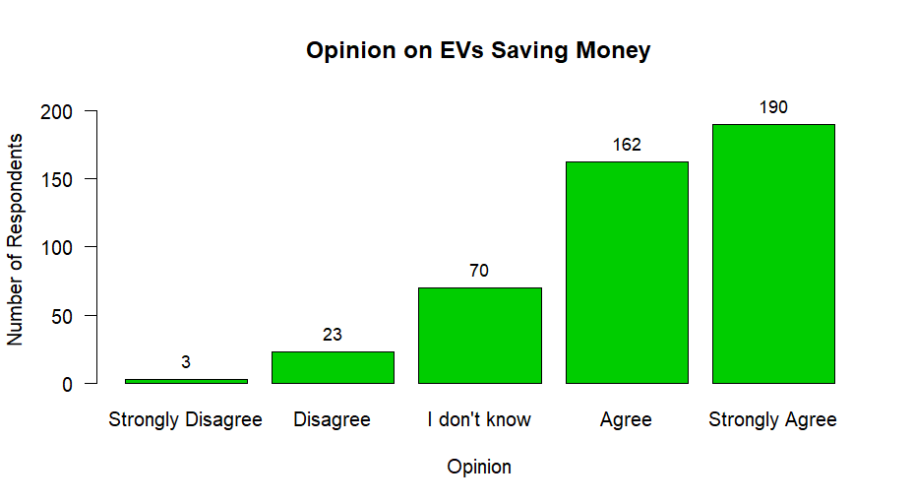
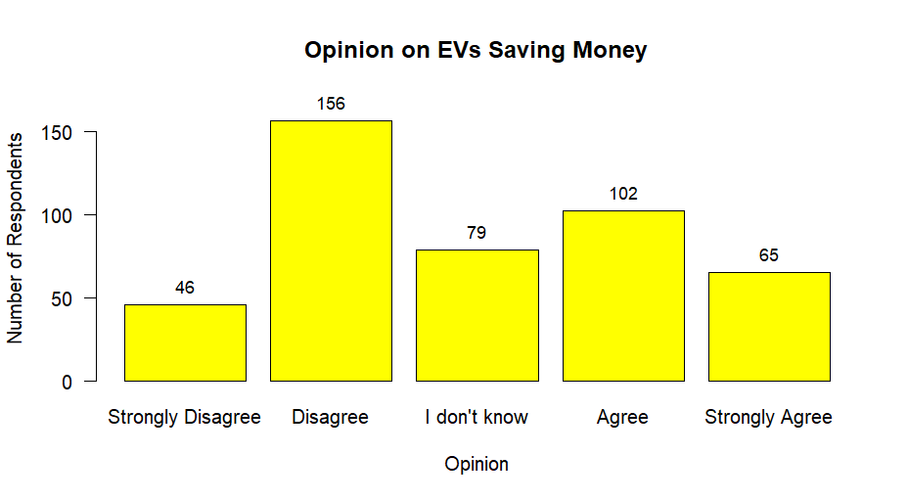
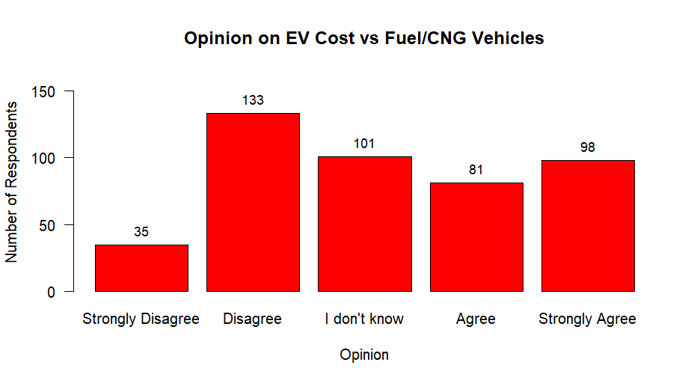
Interpretation: Among 448 respondents, 102 respondents responded that Evs are expensive to buy. 65 people strongly agreed that EVs are expensive. But , 156 respondents responded that Evs are not expensive , i.e., they disagreed to this fact and also 46 people strongly disagreed to this fact. 79 responded that they didn’t know about this fact.
Interpretation: Out of 448 respondents , 164 strongly agreed and 193 agreed that EV saves a lot of money of the owner. 20 people disagreed and 2 people strongly disagreed with the same fact. And 69 people responded that they didn’t know about this fact.
Interpretation: Among 448 respondents, 81 agreed and 98 strongly agreed to the fact that EV costs about the same to buy a Fuel/ CNG vehicles. 35 strongly disagreed and 133 disagreed to the fact that EV costs about the same to buy a Fuel/CNG vehicle. And 101 responded that they didn’t know about this fact.

Slide 12
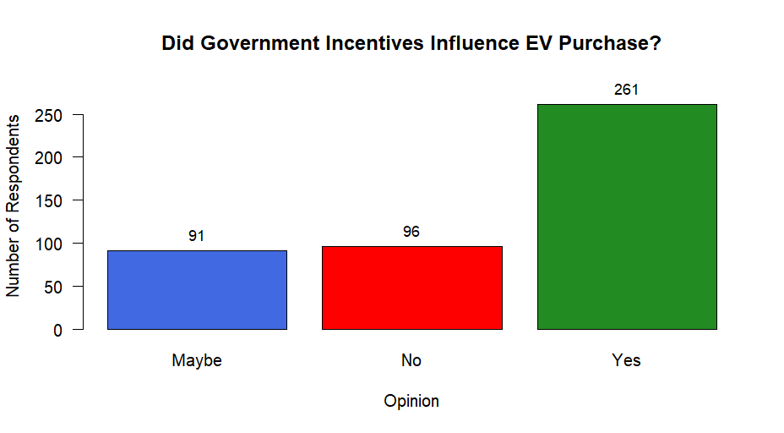
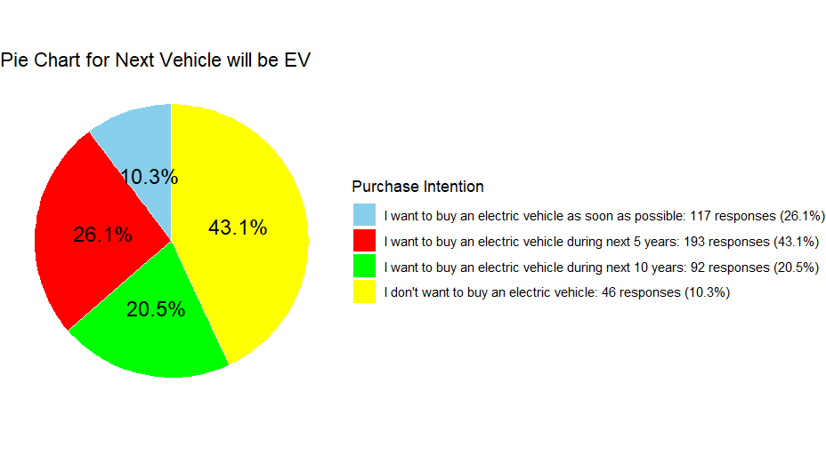
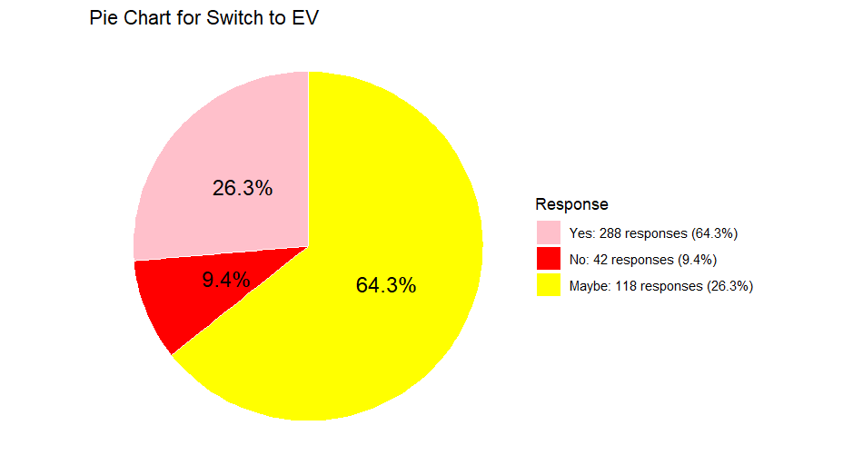
Interpretation: The pie chart shows that 117 respondents wants to buy an EV as soon as possible. 193 responded that they wants to buy an EV during next 5 years. 92 responded that they wants to buy EV during next 10 years and 46 responded that they don’t want to buy an EV.
Interpretation: The pie chart represents that among 448 respondents 288 respondents wants to switch to EV if the company offers an exchange value on their owned vehicle to buy an electric vehicle. 42 responded that they don’t want to switch to EV even if the company offers an exchange value on their owned vehicle to buy an electric vehicle. And 118 respondents responded that maybe they will switch to EV if the company offers an exchange value on their owned vehicle to buy an electric vehicle.
Interpretation: The bar chart shows that government incentives have influenced the consumer decision to buy an EV. 261 respondents responded that they are influenced by government incentives. 96 responded that they aren’t influenced by government incentives. And lastly 91 responded that maybe they are influenced by government incentives.

Slide 13
Chi square test of association:-
The Chi-square Test provides a method for testing the association between the row and column variables in a two-way table (contingency table) consisting of categorical data.
Battery replacement expensive | Next vehicle EV
 | I don’t want to buy an electric vehicle | I want to buy an electric vehicle as soon as possible | I want to buy an electric vehicle during next 10 years | I want to buy an electric vehicle during next 5 years | TOTAL
MAYBE | 24 | 49 | 40 | 64 | 177
NO | 2 | 16 | 4 | 7 | 29
YES | 20 | 52 | 48 | 122 | 242
TOTAL | 46 | 117 | 92 | 193 | 448
Gender | Preference of type of vehicle |  |  | TOTAL
 | CNG/Fuel vehicle | Electric vehicle | Pedal -driven vehicle
Male | 51 | 201 | 14 | 266
FEMALE | 43 | 119 | 20 | 182
TOTAL | 94 | 320 | 34 | 448
Gender | OCCUPATION |  |  |  | TOTAL
 | Home maker | Others | Self employed | Student
Male | 44 | 17 | 12 | 109 | 182
FEMALE | 1 | 102 | 75 | 88 | 266
TOTAL | 45 | 119 | 87 | 197 | 448
χ² = 7.2573
p value = 0.02655
df =2
χ² = 7.2573
p value = 0.02655
df =2
Interpretation: This Table depicts how battery replacement of EV is expensive is associated with the next vehicle EV. Here, p-value < 0.05, thus the null hypothesis is rejected , i.e there is sufficient evidence of association between battery replacement of EV is expensive with next vehicle will be EV .
Interpretation: This table depicts how gender is associated with the preference of type of vehicle. Here, p-value < 0.05, thus the null hypothesis is rejected, i.e. there is sufficient evidence of association between gender with preference of type of vehicle.
Interpretation: This table depicts how occupation are associated with the gender. Here, p-value < 0.05, thus the null hypothesis is rejected, i.e there is sufficient evidence of association between occupation with respect to gender.
χ² = 23.133
p value = 0.0007533
df = 6

Slide 14
Costs same as CNG/Fuel vehicle | Next vehicle would be EV |  |  |  | TOTAL
 | I Don’t want to buy an EV | I want to buy an Ev as soon as possible | I want to buy an EV during the next 10 years | I want to buy an EV during the next 5 years
Agree | 10 | 23 | 21 | 27 | 81
Disagree | 5 | 44 | 18 | 66 | 133
I don’t know | 25 | 16 | 25 | 35 | 101
Strongly agree | 5 | 28 | 11 | 54 | 98
Strongly disagree | 1 | 6 | 17 | 11 | 35
TOTAL | 46 | 117 | 92 | 193 | 448
Age group | Next vehicle would be EV |  |  |  | TOTAL
 | I Don’t want to buy an EV | I want to buy an Ev as soon as possible | I want to buy an EV during the next 10 years | I want to buy an EV during the next 5 years
18-22 | 35 | 26 | 48 | 57 | 166
23-30 | 6 | 33 | 12 | 59 | 110
Above 30 | 3 | 43 | 23 | 68 | 137
Below 18 | 2 | 15 | 9 | 9 | 35
TOTAL | 46 | 117 | 92 | 193 | 448
χ² = 70.798
p value = 2.271e-10
df = 12
χ² = 65.246
p value = 9.087e-07
Interpretation: This table depicts how cost to buy an EV is same as CNG/Fuel Vehicle are associated with next vehicle will be EV. Here, p-value < 0.05, thus the null hypothesis is rejected, i.e., there is sufficient evidence of association between cost to buy an EV is same as CNG/Fuel Vehicle with next vehicle will be EV.
Interpretation: This table depicts age group are associated with next vehicle will be EV. Here,
p-value < 0.05, thus the null hypothesis is rejected, i.e., there is sufficient evidence of association between age with next vehicle will be EV.

Slide 15
Occupation EV is expensive | Home Maker | Others | Self Employed | Student | Total
Agree | 10 | 14 | 16 | 62 | 102
Disagree | 25 | 49 | 35 | 47 | 156
I don't know | 4 | 17 | 10 | 48 | 79
Strongly Agree | 3 | 11 | 22 | 29 | 65
Strongly Disagree | 3 | 28 | 4 | 11 | 46
Total | 45 | 119 | 87 | 197 | 448
1.373e-11
Buy EV Gov. Incent -ives Influenced | I don't want to buy an electric | I want to buy an electric vehic | I want to buy an electric vehic | I want to buy an electric vehic | All
Maybe | 18 | 15 | 24 | 34 | 91
No | 21 | 16 | 29 | 30 | 96
Yes | 7 | 86 | 39 | 129 | 261
All | 46 | 117 | 92 | 193 | 448
1.373e-11
1.373e-11
χ² = 76.756
p value = 0.2302
df = 12
χ² = 62.534
p value = 1.373e-11
df = 6
Interpretation: This table depicts how occupation are associated with EV is expensive. Here, p-value > 0.05, thus the null hypothesis is accepted.
Interpretation: This table depicts how gov. incentives are associated with next vehicle will be EV. Here, p-value > 0.05, thus the null hypothesis is accepted.

Slide 16
Switch to EV Gov. incentives | Maybe | No | Yes | Total
Maybe | 51 | 9 | 31 | 91
No | 39 | 22 | 35 | 96
Yes | 28 | 11 | 222 | 261
Total | 118 | 42 | 288 | 448
Switch to EV Residen- tial Area | Maybe | No | Yes | Total
Rural | 50 | 21 | 199 | 270
Urban | 68 | 21 | 89 | 178
Total | 118 | 42 | 288 | 448
χ² = 130.299
p value = 0.216
df = 4
χ² = 27.006
p value = 0.325
df = 2
Interpretation: This table depicts how gov. incentives are associated with switching to EV. Here, p-value > 0.05, thus the null hypothesis is accepted.
Interpretation: This table depicts how residential area are associated with switching to EV if the company offers an exchange value on your owned vehicle to buy an electric vehicle. Here, p-value > 0.05, thus the null hypothesis is accepted.

Slide 17
Analysis of variance:
Anova: Single Factor (summary)
Tests based on one-way ANOVA:
Group | Count | Mean | Variance
Group 1 | 166 | 1.7771 | 0.42876304
Group 2 | 110 | 1.8909 | 0.24482704
Group 3 | 137 | 1.9343 | 0.10595025
Group 4 | 35 | 1.9429 | 0.17313921
[Test-1]
Denoting the “Age” column into four groups respectively:
● Group 1: Below 18
● Group 2: 18-22 years
● Group 3: 23-30 years
● Group 4: Above 30 years
Each group has entries of preference of vehicles for each individual. So, we want to test whether there is any effect of age grouping on preference of vehicle(𝐻_{𝑎}) or not(𝐻₀ ). The test report is as follows:
Anova table for Single Factor
S.O.V. | df | SS | MS
Age | 3 | 2.226 | 0.7420
Error | 444 | 117.738 | 0.2652
Total | 447 | 119.964 | -----
F | p
0.80 | 0.040
------ | ------

Slide 18
Here we divide our data into 4 groups respective to their age:
● Group 1: Below 18
● Group 2: 18-22 years
● Group 3: 23-30 years
● Group 4: Above 30 years
Each group has entries of preference of vehicles for each individual. So, we want to test whether there is any effect of age grouping on preference of vehicle(𝐻_{𝑎}) or not(𝐻₀ ). As the null hypothesis get rejected for between the groups , so we do Fisher Individual Tests for Differences of Means to test which groups have significant differences between them . And hence we conclude that the difference between the means of age group above 30 years and 18-22 years is satistically significant.
Table for Fisher Individual Tests for Differences of Means
Difference of Levels | Difference of Means | SE of Difference | 95% CI | t-Value | Adjusted P-Value
23-30 - 18-22 | 0.1138 | 0.0633 | (-0.0106, 0.2382) | 1.80 | 0.073
Above 30 - 18-22 | 0.1572 | 0.0594 | (0.0404, 0.2740) | 2.64 | 0.008
Below 18 - 18-22 | 0.1657 | 0.0958 | (-0.0225, 0.3540) | 1.73 | 0.084
Above 30 - 23-30 | 0.0434 | 0.0659 | (-0.0862, 0.1730) | 0.66 | 0.511
Below 18 - 23-30 | 0.0519 | 0.0999 | (-0.1445, 0.2484) | 0.52 | 0.603
Below 18 - Above 30 | 0.0086 | 0.0975 | (-0.1831, 0.2002) | 0.09 | 0.930
Simultaneous confidence level = 79.88%

Slide 20
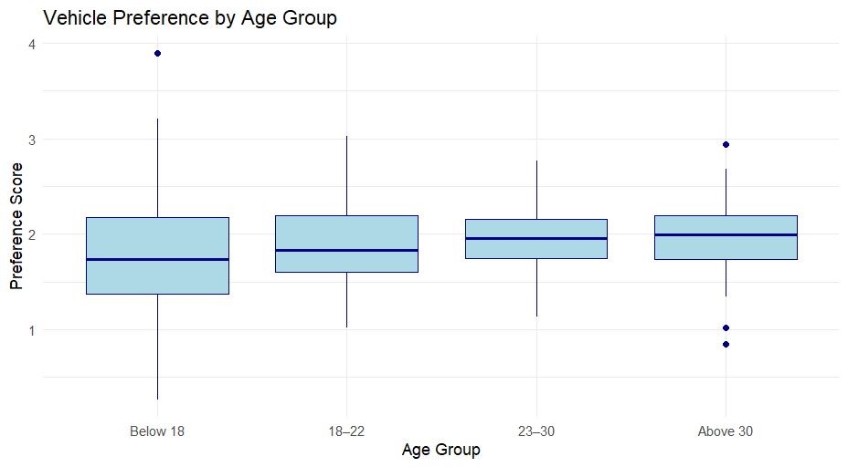
There’s notable overlap among groups but subtle upward trends in median from "Below 18" to "Above 30".
this boxplot reinforces the idea that age might influence vehicle preference, especially for older vs younger age brackets.

Slide 21
Confusion Matrix:
A confusion matrix is a table used to evaluate the performance of a classification model—especially in supervised machine learning. It compares the predicted labels with the actual labels and breaks down the results into four categories:
📊 Structure of a Confusion Matrix
 | Actual Positive (1) | Actual Negative (0)
Predicted Positive (1) | True Positives (TP) | False Positives (FP)
Predicted Negative (0) | False Negatives (FN) | True Negatives (TN)
🔍 What Each Term Means
- True Positives (TP): Model correctly predicted the positive class.
- True Negatives (TN): Model correctly predicted the negative class.
- False Positives (FP): Model incorrectly predicted positive when it was actually negative (Type I error).
- False Negatives (FN): Model incorrectly predicted negative when it was actually positive (Type II error).
📈 Why It’s Useful
The confusion matrix helps calculate key performance metrics:
Accuracy = (TP + TN) / Total predictions
Precision = TP / (TP + FP)
Recall (Sensitivity) = TP / (TP + FN)
Specificity = TN / (TN + FP)
F1 Score = Harmonic mean of precision and recall

Slide 22
Confusion matrix for first model -
Predicted Labels | Actual Labels
 | 0 | 1
0 | 266 | 18
1 | 0 | 164
The model has a high overall accuracy of 96%, meaning that it correctly predicts the outcome for approximately 96% of the data points. The precision of 100% suggests that when the model predicts a positive outcome, it is correct every time. This indicates that the model has zero false positives. The recall (sensitivity) of 90.1% indicates that the model can identify the majority of actual positive instances correctly. This means it has a low rate of false negatives, missing only a small portion of the positive cases. The high specificity of 100% implies that the model has a very low rate of false positives, correctly identifying all negative instances. The high F1-score of 0.948 indicates an excellent balance between precision and recall. This suggests that the model is performing strongly in capturing the positive instances while maintaining a perfect false positive rate.
True Positives (TP): The number of samples correctly predicted as positive (actual 1, predicted 1) is 164.
True Negatives (TN): The number of samples correctly predicted as negative (actual 0, predicted 0) is 266.
False Positives (FP): The number of samples incorrectly predicted as positive (actual 0, predicted 1) is 0.
False Negatives (FN): The number of samples incorrectly predicted as negative (actual 1, predicted 0) is 18.
Accuracy = 0.96
Precision = 1
Recall (Sensitivity) = 0.901
Specificity = 1
F1-score = 0.948

Slide 23
Confusion matrix for second model -
Predicted Labels | Actual Labels
 | 0 | 1
0 | 270 | 14
1 | 0 | 164
• The model has a high overall accuracy of 96.9%, meaning that it correctly predicts the outcome for approximately 96.9% of the data points. The precision of 100% suggests that when the model predicts a positive outcome, it is correct every time. This indicates that the model has zero false positives. The recall (sensitivity) of 92.1% indicates that the model can identify the majority of actual positive instances correctly. This means it has a low rate of false negatives, missing only a small portion of the positive cases. The high specificity of 100% implies that the model has a very low rate of false positives, correctly identifying all negative instances. The high F1-score of 0.959 indicates an excellent balance between precision and recall. This suggests that the model is performing strongly in capturing the positive instances while maintaining a perfect false positive rate.
True Positives (TP): The number of samples correctly predicted as positive (actual 1, predicted 1) is 164. True Negatives (TN): The number of samples correctly predicted as negative (actual 0, predicted 0) is 270. False Positives (FP): The number of samples incorrectly predicted as positive (actual 0, predicted 1) is 0. False Negatives (FN): The number of samples incorrectly predicted as negative (actual 1, predicted 0) is 14. Accuracy = 0.969 Precision = 1 Recall (Sensitivity) = 0.921 Specificity = 1 F1-score = 0.959

Slide 24
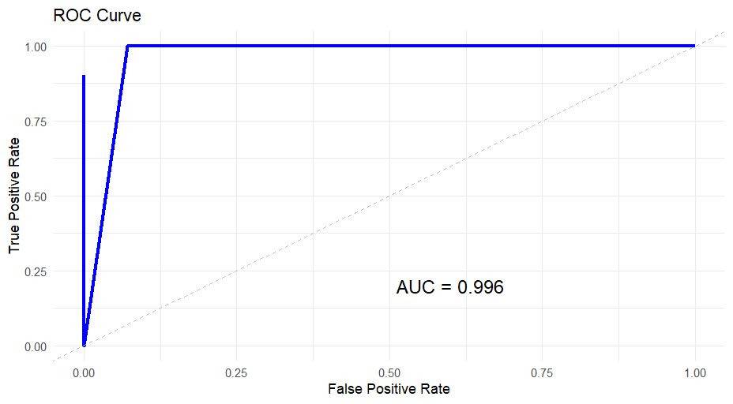
Multiple logistic regression model:
Model 1:
Covariate are :
Age, Occupation, Highest educational qualification, Family income,Next vehicle would be EV, Influenced by Government incentives
Here ,
AIC : 89.2658611732685
AUC : 0.996
Binary response is Gender
Here we want to predict the consumption of EV based on genders.
Interpretation: The ROC plot shows how well the logistic regression model distinguishes between male and female respondents based on predictors like age, occupation, education, income, EV preference, and government incentives. The curve's shape and the high AUC value (0.996) indicate excellent classification performance.
An AIC of 89.27 suggests the model fits the data well with a reasonable level of complexity. Lower AIC values are preferred when comparing models—so this score reflects a strong balance between accuracy and simplicity.

Slide 25

Model 2:
Covariate are :
Age, Occupation, Highest educational qualification, Family income,Next vehicle would be EV, Reduces global warming
Binary response is residential area
Here we want to predict the the level of concern
regarding environmental pollution among the
respondents.
Here,
AIC:89.0815865038871
AUC : 0.997
A lower AIC value indicates a better-fitting model.
Interpretation: The ROC plot shows how well the logistic regression model distinguishes between Urban and Rural respondents based on predictors like age, occupation, education, income, belief in EV impact, and EV purchase intention. The curve’s shape and the high AUC value (0.997) indicate excellent classification performance.
An AIC of 89.08 suggests the model fits the data well with a reasonable level of complexity. Lower AIC values are preferred when comparing models—so this score reflects a strong balance between accuracy and simplicity.

Slide 26
Principal Component Analysis:
Here, I have used age, gender, occupation, educational qualification and family income as variables for plotting the PCA and finding out the correlation matrix.
Eigen analysis of the Correlation Matrix
Eigen value | 1.1453 | 1.1172 | 0.9775 | 0.9547 | 0.8052
Proportion | 0.229 | 0.223 | 0.196 | 0.191 | 0.161
Cumulative | 0.229 | 0.453 | 0.648 | 0.839 | 1.000
Interpreting the Table
The first eigenvalue is 1.1453, which explains 22.9% of the total variance. The first two components together explain 45.3% of the total variance. The first three components explain 64.8% of the total variance. By the fourth component, 83.9% of the total variance is explained. All five components together explain 100% of the variance, as expected.
This table helps in deciding how many principal components to retain for dimensionality reduction or further analysis. Components with lower eigenvalues contribute less to explaining the variance and might be dropped to simplify the model without significant loss of information.

Slide 27
Principal Component Loadings Table
Variable | PC1 | PC2 | PC3 | PC4 | PC5
Gender | -0.079 | -0.246 | 0.924 | -0.004 | -0.283
Age | 0.151 | 0.648 | 0.243 | 0.683 | 0.177
Occupation | -0.458 | 0.596 | -0.062 | -0.290 | -0.589
Highest educational qualification | -0.715 | 0.061 | 0.158 | -0.130 | 0.666
Family income | -0.500 | -0.400 | -0.243 | 0.657 | -0.314
This table represents the eigen vectors resulting from a Principal Component Analysis (PCA) on a dataset. Each row corresponds to a variable in the dataset, and each column (PC1, PC2, PC3, PC4, PC5) corresponds to a principal component. The values in the table indicate the loadings of each variable on the principal components.
In this context:
Gender has a strong loading on PC3.
Age has strong loadings on PC2 and PC4.
Occupation has significant loadings on PC1, PC2, and PC5.
Education has strong loadings on PC1 and PC5.
Family income has strong loadings on PC1 and PC4.

Slide 28
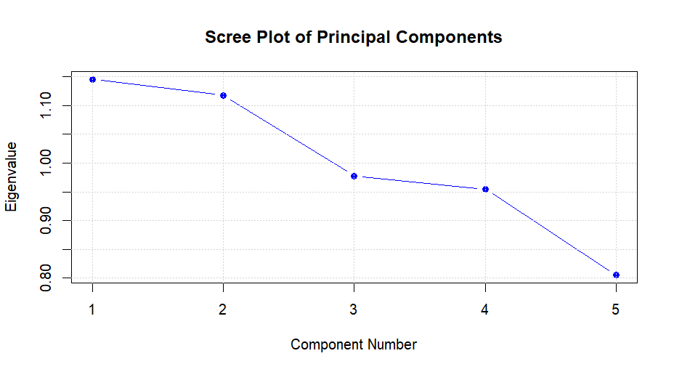
Scree Plot -
Interpretation: Here on the x-axis we’ve component numbers and on the y-axis we have eigenvalues. In the given scree plot, it looks like the eigenvalues start to level off after the third component, suggesting that the first three components explain most of the variance in the data.

Slide 29
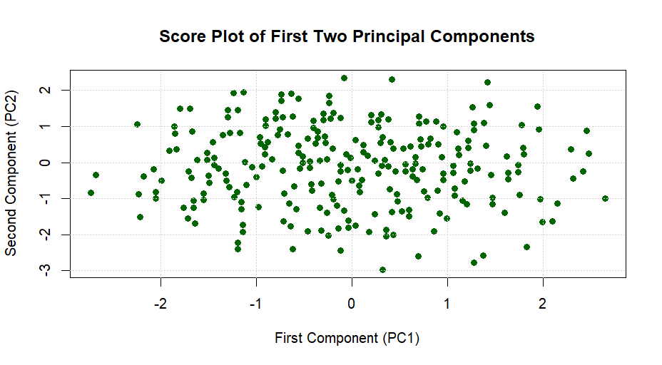
Score Plot -
Interpretation: Here on the x-axis we’ve first component and on the y-axis we have second component. In this plot, you can observe the spread and clustering of the data points along the first and second principal components. This can give you an idea of how the observations are distributed and how they relate to each other in the reduced dimensionality space

Slide 30
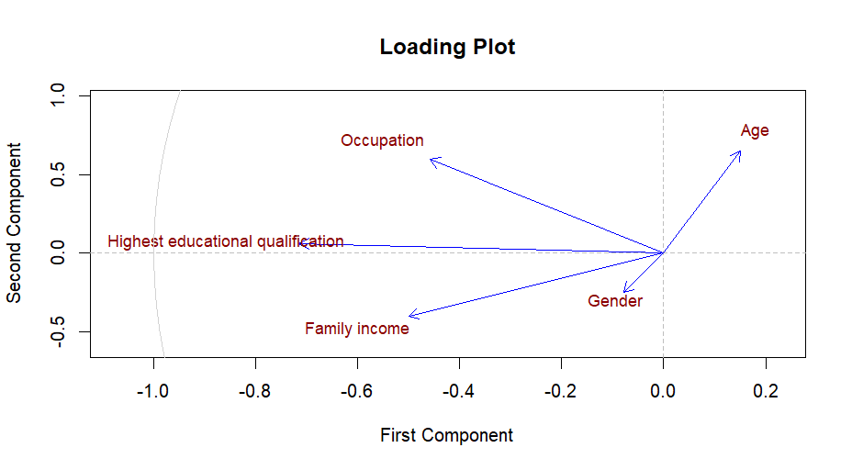
Loading Plot -
Interpretation: Here on the x-axis we’ve first component and on the y-axis we have second component. The plot helps to understand the relationships between the variables and how they contribute to the principal components. Variables pointing in the same direction are positively correlated, while those pointing in opposite directions are negatively correlated. In summary, this loading plot shows how each variable contributes to the principal components and their correlations.

Slide 31
Conclusion :-
Our aim to find the consumers behaviour towards buying an EV is well achieved.
The respondents are aware of global climate conditions and are ready to change but their cost is an important factor while considering the purchase of EV. If sufficient infrastructure is available, respondents are inclined to simply accept EV’s as future buying option.
The cost of replacement of battery , Lack of charging station, Long recharging time and mileage are all major factors that limit consumer confidence.
If all these factors can be taken into consideration, then consumption of EV will increase which will reduce pollution and the problem of global warming will also reduce.

Slide 32
THANK YOU -------------- 0 --------------

